Slide 1
BT201
Biochemical Process Calculations
14/09/2022
(Extra lecture)

Slide 2
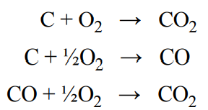

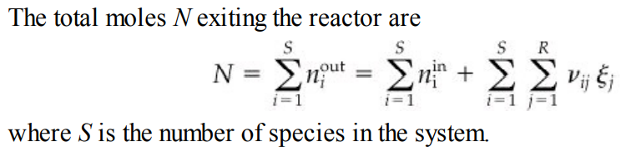
Balances of reactive process with multiple reactions
In practice, reaction systems rarely involve just a single reaction. There may be a primary reaction (e.g., the desired reaction), but often there are additional or side reactions.
Multiple reaction:
Parallel: A+B→C+D
A+B→E+F
Series A→B → C

Slide 3
Analysis of a Bioreactor with multiple reactions
A bioreactor is a vessel in which biological reactions are carried out involving enzymes, microorganisms, and/or animal and plant cells. In the anaerobic (in the absence of oxygen) fermentation of grain, the yeast Saccharomyces cerevisiae digests glucose (C6H12O6 ) from plants to form the products ethanol (C2H5OH) and propenoic acid (C2H3CO2H) by the following overall reactions:
Reaction 1: C₆H₁₂O₆ → 2C₂H₅OH + 2CO₂
Reaction 2: C₆H₁₂O₆ → 2C₂H₃CO₂H + 2H₂O
In a process, a tank is initially charged with 4000 kg of a 12% solution of glucose in water. After fermentation, 120 kg of CO2 have been produced and 90 kg of unreacted glucose remain in the broth. What are the weight (mass) percents of ethanol and propenoic acid in the broth at the end of the fermentation process? Assume that none of the glucose is retained by the microorganisms.

Slide 4
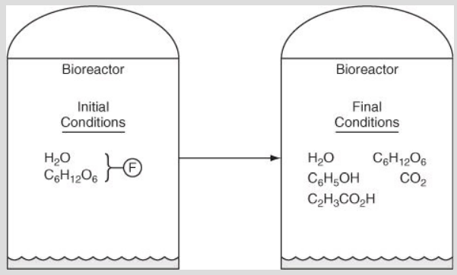
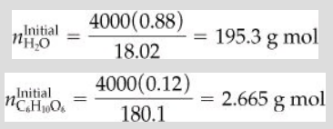
Reaction 1: C6H12O6 → 2C2H5OH + 2CO2 ​
Reaction 2: C6H12O6 → 2C2H3CO2H + 2H2O ​
​
F = 197.965 g mol or rounded to 198 g mol

Slide 5
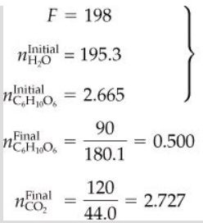

Reaction 1: C₆H₁₂O₆ → 2C₂H₅OH + 2CO₂
Reaction 2: C₆H₁₂O₆ → 2C₂H₃CO₂H + 2H₂O
a net of five unknowns exist for this problem
The degree-of-freedom analysis
5 unknown variables+2 independent reactions-5 expression-2 relations
=0

Slide 6

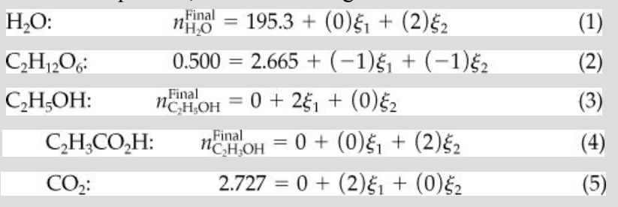
The set of material balance equations, after introducing the known values for the variables, is
Reaction 1: C₆H₁₂O₆ → 2C₂H₅OH + 2CO₂
Reaction 2: C₆H₁₂O₆ → 2C₂H₃CO₂H + 2H₂O

Slide 7
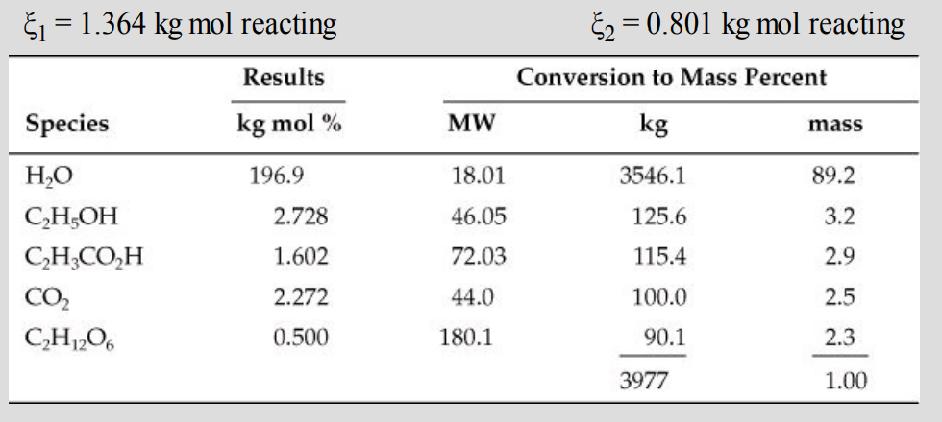
The total mass of 3977 kg is close enough to 4000 kg of feed to validate the results of the calculations

Slide 8
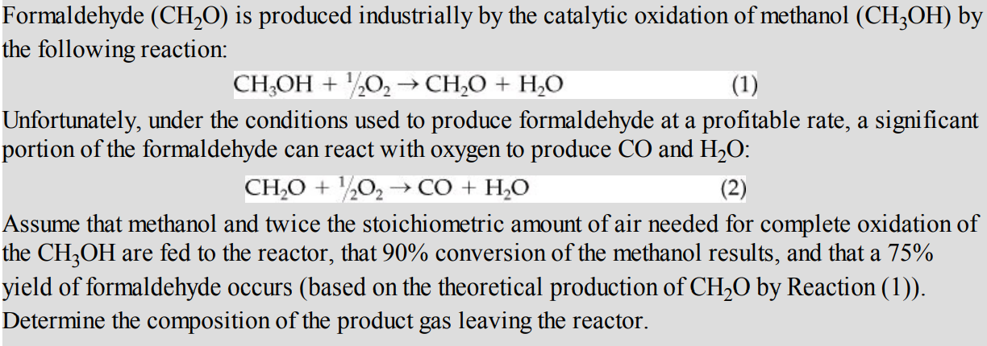
Formaldehyde (CH₂O) production by the catalytic oxidation of methanol
Series reaction with respect to CH₂O

Slide 9
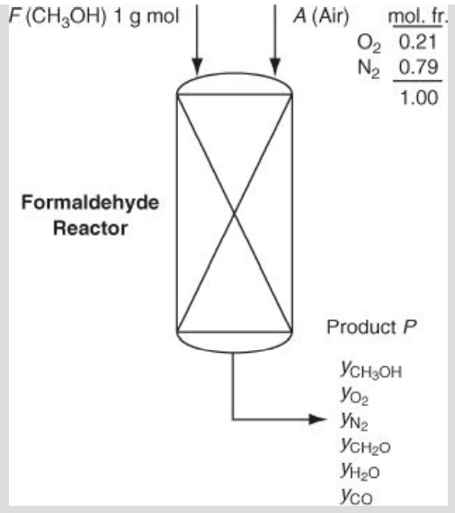



Slide 10


Based on the specified conversion, the extent of reaction for Reaction (1):
Let ξ1 represent the extent of reaction for Reaction (1) and
ξ2 represent the extent of reaction for Reaction (2).
The limiting reactant is CH3OH.

Slide 11
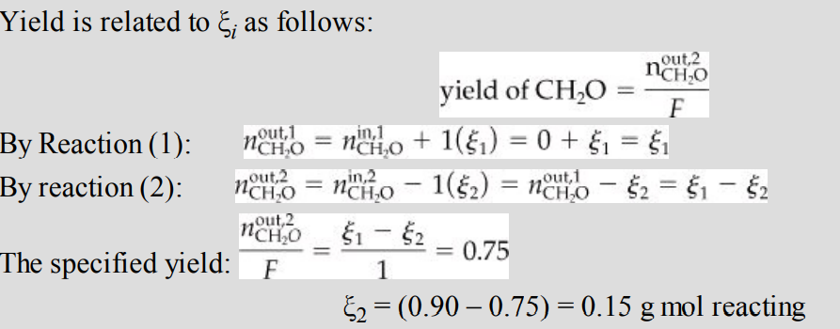


Slide 12
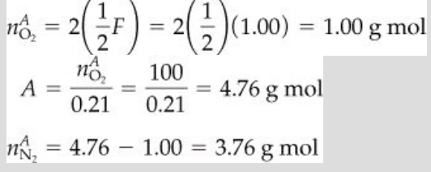
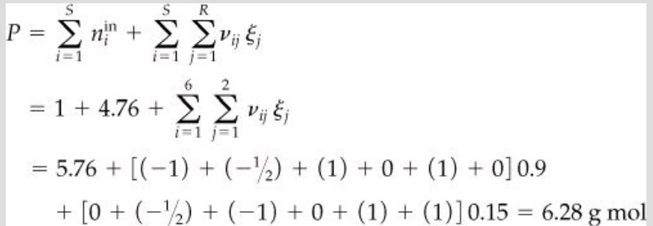
The entering oxygen is twice the required oxygen based on Reaction (1), namely

Slide 13
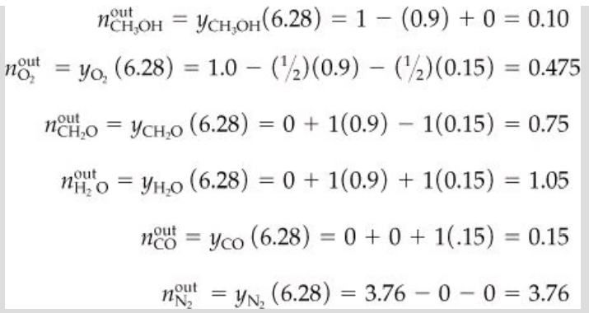

Slide 14
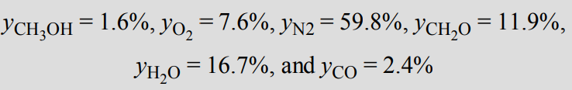
P=6.28 g mole

